Slide 1
Debugging in Visual Studio
Presented By :Sudan Prajapati

Slide 2
Introduction
In the software development life cycle, testing and defect fixing take more time than actually code writing.
In general, debugging is a process of finding out defects in the program and fixing them.
Defect fixing comes after the debugging, or you can say they are co-related. When you have some defects in your code, first of all you need to identify the root cause of the defect, which is called the debugging.
When you have the root cause, you can fix the defect to make the program behavior as expected.

Slide 3
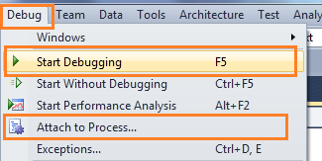
How to start Debug?
You can start debugging from the Debug menu of VS IDE. From the Debug menu.
You can select "Start Debugging" or just press F5 to start the program.
If you have placed breakpoints in your code then execution will begin automatically.

Slide 4
Breakpoints
Breakpoint is used to notify debugger where and when to pause the execution of program.
You can put a breakpoint in code by clicking on the side bar of code or by just pressing F9 at the front of the line.
Before keeping a breakpoint, you should know what is going wrong in your code and where it has to be stopped.
When the debugger reaches the breakpoint, you can check out what's going wrong within the code by using a different debugging tool.

Slide 5
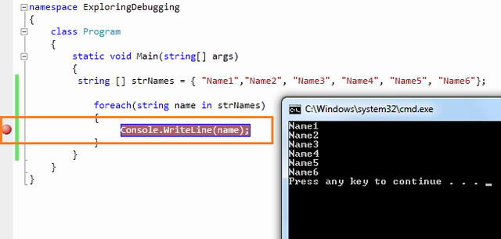

Slide 6
Debugging with Breakpoints
You have already set a breakpoint in your code where you want to pause the execution.
Now start the program by pressing "F5".
When the program reaches the breakpoint, execution will automatically pause.
Now you have several options to check your code.
After hitting the breakpoint, breakpoint line will show as yellow color which indicates that this is the line which will execute next.
Now you have several commands available in break mode, using which you can proceed for further debugging.

Slide 7
Step Over
After debugger hits the breakpoint, you may need to execute the code line by line.
"Step Over" [ F10 ] command is used to execute the code line by line.
This will execute the currently highlighted line and then pause.
If you select F10 while a method call statement is highlighted, the execution will stop after the next line of the calling statement.
Step Over will execute the entire method at a time.

Slide 8
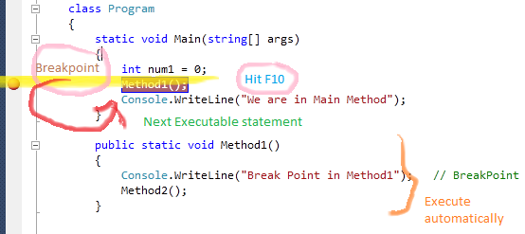

Slide 9
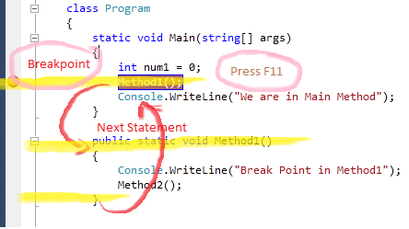
Step Into
This is similar to Step Over.
The only difference is, if the current highlighted section is any methods call.
The debugger will go inside the method. Shortcut key for Step Into is "F11".

Slide 10
STEUP OUT AND CONTINUE
This is related when you are debugging inside a method.
If you press the Shift - F11 within the current method,
Then the execution will complete the execution of the method and will pause at the next statement from where it called.
It's like run your application again.
It will continue the program flow unless it reaches the next breakpoint.
The shortcut key for continue is "F5"

Slide 11
class Program
{
static void Main(string[] args)
{
string[] strNames = { "Name1", "Name2", "Name3", "Name4", "Name5", "Name6" };
foreach (string name in strNames)
{
Console.WriteLine(name); // BreakPoint
}
int temp = 4;
for (int i = 1; i <= 10; i++)
{
if (i > 6)
temp = 5;
}
}
public static void Method1()
{
Console.WriteLine("Break Point in Method1"); // BreakPoint
}
public static void Method2()
{
Console.WriteLine("Break Point in Method2"); // BreakPoint
Console.WriteLine("Break Point in Method2"); // BreakPoint
}
public static void Method3()
{
Console.WriteLine("Break Point in Method3"); // Breakpoint
}
}

Slide 12
Task
WAP making a new class helper.cs and make all function in helper.cs and from main function just call the function and use the debugger to understand the flow of your program.

